Slide 1


Slide 2
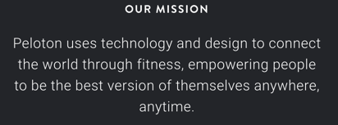


Peloton
Peloton is a technology-driven fitness equipment and media company that provides premium at-home fitness experiences, including connected fitness equipment, apparel, and digital classes.
The company was founded in 2012 and is headquartered in New York City.
Peloton's defining product is a stationary bike with a large touch screen that streams live and recorded fitness classes to the user's house.
Peloton offers a digital membership that provides access to its entire library of live and on-demand classes, personalized workout recommendations, and social features.
Peloton has established itself as a leader in the connected fitness industry and has achieved success in creating a strong brand image through its marketing efforts and collaborations, in addition to its product offerings.

Slide 3
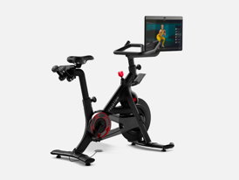
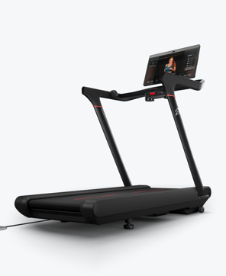




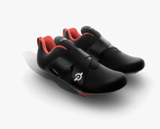
Products / Services
Notes:
Our company's products are stationary bicycles, treadmills, strength guides, indoor rowers, apparel, accessories and the Peloton app. Our exercise machines are all equipped with Internet-connected touch screens that stream live and on-demand fitness classes through a subscription service. The equipment includes built-in sensors that track metrics such as power output, providing users with real-time feedback on their performance and leaderboard rankings to compete with other users.

Slide 4
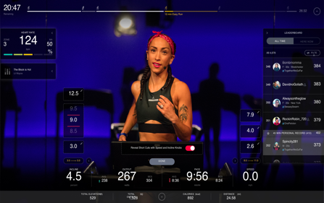
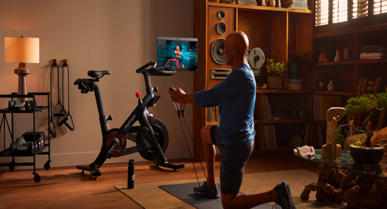
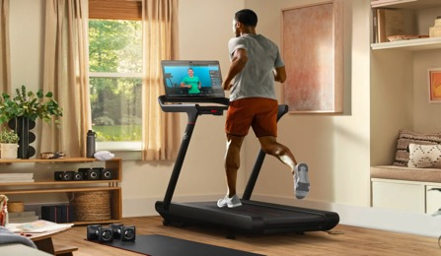

Products / Services
Notes:
Our company's products are stationary bicycles, treadmills, strength guides, indoor rowers, apparel, accessories and the Peloton app. Our exercise machines are all equipped with Internet-connected touch screens that stream live and on-demand fitness classes through a subscription service. The equipment includes built-in sensors that track metrics such as power output, providing users with real-time feedback on their performance and leaderboard rankings to compete with other users.

Slide 5
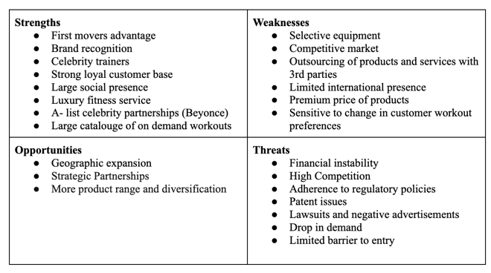
Peloton SWOT Analysis

Slide 6
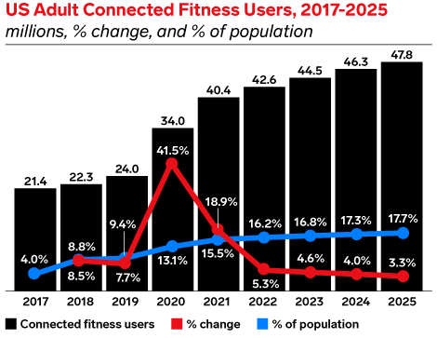
Connected Fitness Industry
$15 Billion Market Cap
Highly competitive
Cardio and strength based
Largest Markets
  North America (35%)
  Japan
  China
  UK
  France
Key Market Drivers
  Rising health concerns
  Growing tech advancements
  Wearables
Notes:
Connected fitness allows users to get the same personal experience they would get at a gym. Just as a personal trainer would assess your strengths and weaknesses and adjust your workout accordingly, connected fitness apps monitor a person's activities to give real-time feedback.
In 2022, over 42.6 million people used a connected fitness platform at least once a month

Slide 7
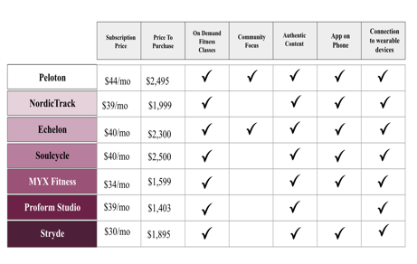
Competitors
Saturated Market
Identical Products / Offerings
Minimal differentiation

Slide 8
Post Pandemic Usage Declines
Peloton experienced a significant increase in revenue during the COVID-19 pandemic due to their first-mover advantage in the Connected Fitness industry, with sales increasing by 172%, monthly workouts doubling, and over a million new users purchasing subscriptions.
Despite its initial success, Peloton's stock value plummeted to $12.75 in February 2023, a 56.03% decrease from its IPO of $29 in 2019, due to supply chain hiccups, excessive inventory, dropping demand, error in planning while assuming market trends would last long after the pandemic, competition, expensive recalls, and negative press.
Peloton invested $400 million in a factory to cut costs and bring manufacturing in-house, but with the lifting of COVID-19 restrictions, revenues dramatically dropped due to an increase in outdoor activities and customer attrition.
To cut costs and revive Peloton from its drowning debt, the company underwent managerial restructuring with a new focus on software offerings that brought in profits, leading to more profitability from their subscription sales compared to physical product sales.
The challenge now for Peloton is how to restore, maintain, and grow peak pandemic demand amongst their users, and address its challenge of buyer resistance and financial fragility.
Notes:
Peloton gained popularity during the pandemic with a strong brand presence and revenue generated through customer subscriptions.
Despite initial success, Peloton faced multiple challenges, including supply chain issues, excessive inventory, and dropping demand.
Peloton's stock peaked during the pandemic at $167, but as of February 2023 dropped to $13, a 56% decrease from its IPO.
In order to cut costs and revive the company from its debt, Peloton underwent managerial restructuring, shut down its factory, and focused on its software offerings, which generated more profit than its physical products.
Peloton now faces the challenge of restoring, maintaining, and growing demand among its users, addressing buyer resistance, and managing its financial fragility.

Slide 9
Reasons for Attrition
Peloton's cult-like following during the pandemic resulted in many users becoming obsessed with Peloton's spin classes. However, many of these users soon got burnt out from the same workout routine, and as a result, Peloton adopters have begun to pursue other physical activities like yoga, meditation, strength training, etc.
As gyms reopen, there has been a waning interest in at-home fitness equipment, with reduced demand attributed to an increase in the need for class variety, being around other people and socializing, separation of work and play, and feeling the need to catch up for social events missed during the pandemic.
Peloton users miss the physical presence of others and are looking for a safe space to exercise, free of distractions, amongst a community of people that hold them accountable.
Notes:
User interviews stated 3 main reasons for attrition:
Peloton's cult-like following during the pandemic which led users to become obsessed with spin classes, but eventually got burnt out seeking alternative forms of exercise like yoga and strength training.
With the reopening of gyms, there has been a reduced demand for at-home fitness equipment due to rising need for class variety, socializing, and separating work and exercise environments.
Peloton users are looking for a safe space to exercise, amongst a community of people that hold them accountable.

Slide 10


Recent Rebranding Efforts
Notes:
Within the past year Peloton has made efforts to rebrand themselves through their
new brand positioning “Motivation That Moves You” honors the motivating power of the Peloton experience in helping people lead healthier, happier lives.
Peloton aims to motivate consumers to work out through a combination of high-end instructors, content, music, hardware, and software, making fitness fun and encouraging dedication.

Slide 11
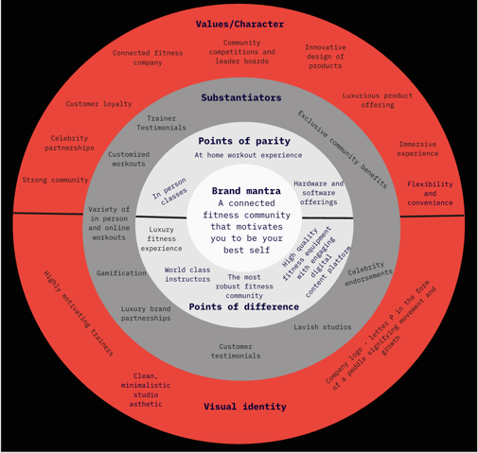
Proposed Rebranding
Specific positioning
Connected fitness community that motivates you to be your best self.
Type of position
Niche, and Horizontal
Notes:
Specific positioning recommendation to achieve differentiation: Connected fitness community (both in person and via digital technology) that motivates you to be your best self.
We would like Peloton to position itself in both a niche and horizontal market. We recommend a niche market because our target users have luxury needs, but we want to create an experience for all types of fitness go -ers at a price point that is affordable for them. Thus, we will have subscription models for many types of users

Slide 12

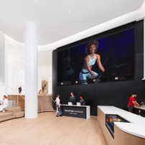
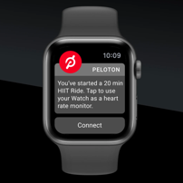

Differentiators
Gamification + New Experiences
Community + In Person Experiences
Luxury / Exclusivity
Notes:
Peloton’s previous differentiator was creating and emphasizing the value of a fitness community. However, as home restrictions are lifted and Peloton users are burning out we recommend a rebrand that emphasizes an exclusive and luxury fitness experience offering both virtual, and in-person classes with enhancements through gamification.

Slide 13
Luxury Fitness Club
Customer Segment
Temple of well-being
State of the art Peloton studios (member only access by retinol scan)
World Class Trainers
Exclusive Partnerships
Exposure to unreleased products
Networking, conferences, education, and other studio events
Demographic - Trainer, parents, professional athlete.
Geographic - Urban population.
Firmography - Wellness clubs, Hotels, Universities, and Corporate Offices.
Psychographic - Fashion enthusiasts, Immersive exercise experts, and Fitness enthusiasts.
Notes:
Your choice of gym says something about you - your taste, your goals, your bodily idea, but we are not a gym. We are a club dedicated to a luxury fitness journey. In order to accomplish this, we recommend Peloton open studios, located primarily in major cities, that are only accessible to Peloton members. The studio will be a site for Peloton community members, events, content creation, new product testing, release parties, and fitness classes. Studio access will cost an additional one hundred dollars per month and provide flexibility to members that are craving more connection with others in the fitness community. Peloton studios provide members with a safe space to work out, connect with other members, meet their favorite trainers, and hold themselves accountable so they are better prepared to achieve their goals. This new membership model meets consumer demand while maintaining the luxury fitness experience exclusive to Peloton members.
Exclusivity / Luxury
your choice of gym says something about you— your taste, your goals, your bodily ideal. But we are not a gym. We are a club dedicated to a luxury fitness journey
tailored to the needs of a growing class of people who are fueled by the belief that working out is part of a ruthlessly efficient lifestyle, without all the bro-culture posturing of other workout experiences.

Slide 14

Peloton Community
Studio + On Demand Classes
Motivation
Accountability
Group Competition
Psychological Safety
Individuals with similar goals
Notes:
Digital and physical community

Slide 15
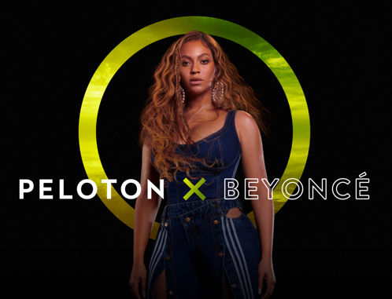
Gamification
Exclusive Tour de France content
Ride with celebrities
Competition + leaderboards
Wearable tech partnerships
New product / pre-release
Increased class variety

Slide 16



Targeted Customer Segments and Value Proposition
Fitness Enthusiasts
Working Parents
Fitness Boutique Users
For extrinsically motivated Fitness Enthusiasts that value convenience, Peloton provides a robust community of users and world-class trainers that will engage you holding you accountable during your fitness journey.
Working parents with inconsistent schedules that revolve around their children and value exercise but can’t make traditional class times, Peloton offers a large catalog of on-demand classes that vary in time and intensity for convenient and flexible workouts.
For our loyal premium customers, our high-end facilities provide you with a luxurious fitness experience tailored to your expectations with top-notch trainers and exclusive member benefits.

Slide 17
Product
Promotion
Price
Place
Stationary Bikes
Treadmills
Accessories
On-demand classes
Immersive Experience
Fitness community
Digital Marketing (Amazon, Social Media)
Celebrity Influencers
Marketing campaigns
Word of mouth
Premium Pricing for equipments
Monthly Subscription
Websites
Retail Showroom
At partner stores (Lululemon)
Notes:
Now, let's look at Peloton from the lens of marketing mix
Peloton offers connected fitness platform that includes both hardware (the Peloton Bike or Tread) and software (the Peloton app).
Peloton's pricing strategy is based on a subscription model, where members pay a monthly fee for access to the platform. The pricing is designed to be premium for the luxury product offerings they have.
Peloton primarily sells its products and services through its websites,ecommerce platforms. Peloton also has showrooms and retail locations where members can try out the equipment and speak with experts.
Peloton's Promotional strategy is focused on building a community around the brand and leveraging social media, influencer marketing to reach new members.

Slide 18
Success Metrics
Non - Financial Metrics
Financial Metrics
Net Promoter Score
Customer Engagement
Customer Experience
Member retention
Fun & Behavioral
Revenue per member
Revenue per session
Return over investment
Additional service revenue per customer
Conversion rate
Market share (for subscriptions)
KEY TAKEAWAY: Financial and Non-Financial metrics are both important to the success of peloton.
Notes:
To map the success of Peloton here are some success metrics that we would like to focus on - they are categorised in 2 buckets - Financial and non-financial
Non-financial
Member retention : With this metric it can give Peloton an idea as how consistently are the subscribers engaging with the product
Fun and behavioral - with this metric Peloton can get a feedback on the new gamification features they have launched and its impact on customer satisfaction/engagement
Financial
Return over investment
With this metric Peloton would be able to gauge how their products are performing in the market.
Along with this we can also track the market share of peloton to benchmark the performance against the competitors.

Slide 19
Risks Involved
Resistance to Adoption of Peloton
Failed Partnerships
Risk of injury with new Product releases
Current inflation in the economy
Dislike in the gamification features
Unexpected product recalls
Notes:
Before concluding, we would like to mention that the rebranding potentially might have some risks associated with it - like Resistance to adoption of peloton products due to the premium pricing or due to some external factors like inflationary economy wherein people won’t be willing to invest in the devices or subscriptions
And as Peloton has physical products there is a possibility of some unprecedented product recalls as well.

Slide 20
Conclusion
Investment in rebranding that address user needs and grievances
Build Peloton Studios
Expand the Peloton community
Increase class variety and gamify exercise
Financial stability
Make fitness fun and motivating
Maintain Peloton as the leading luxury fitness equipment brand
Notes:
To sum it up, due to their significant decline in sales after pandemic, it is essential that Peloton invests in rebranding efforts to enhance the experience and regain their financial stability while making fitness fun and motivating.

Slide 21
Thank You

Slide 22
Appendix

Slide 23
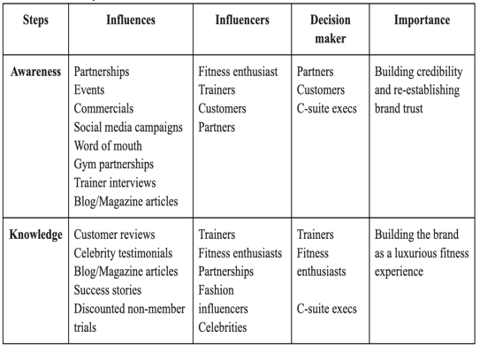
Hierarchy of effects
Notes:
Hierarchy of effects

Slide 24
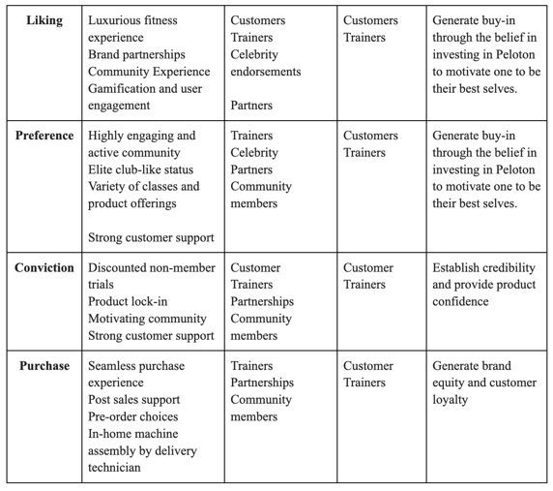

Slide 25
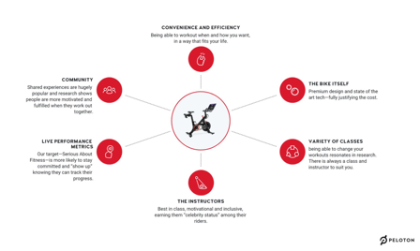
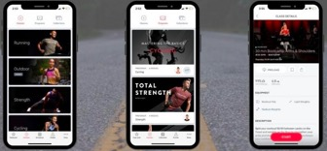
Product Offerings

Slide 26
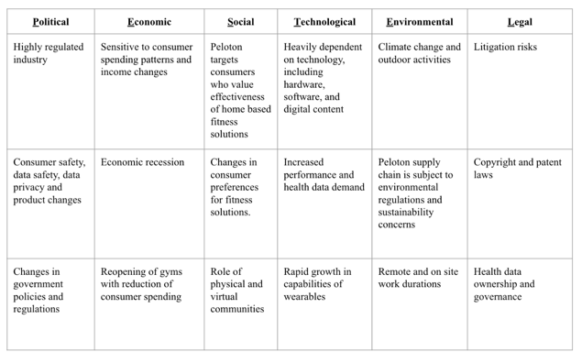
PESTEL

Slide 27
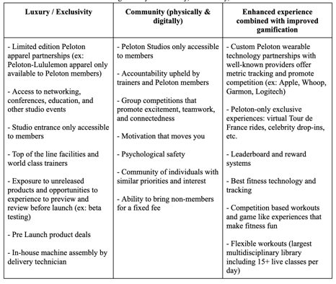
Differentiators

Slide 28

New Top Tier Subscription Model
Access to all devices, content and studios
Opportunity to bring nonmember for fee
In person classes (booked in advance)
Access to events, education, etc in studio
Ability to compete on platform
Studio amenities

Slide 29
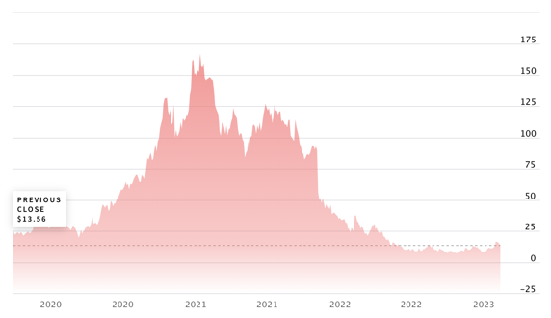
Peloton Stock
Peloton Stock price chart

Slide 30
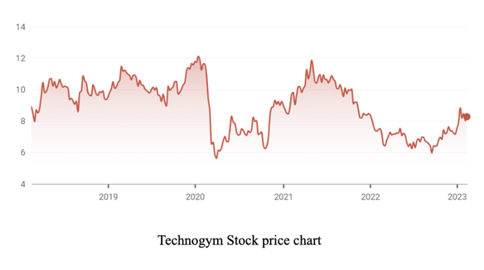
Competitor Stock - Technogym

Slide 31
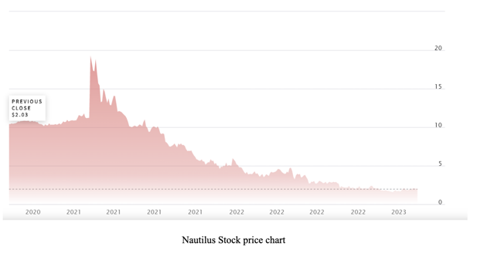
Competitor Stock - Nautilus

